Slide 1

Introduction to NRM Class 4: resource management & governance
Larry Swatuk
lswatuk@mta.ca

Slide 2
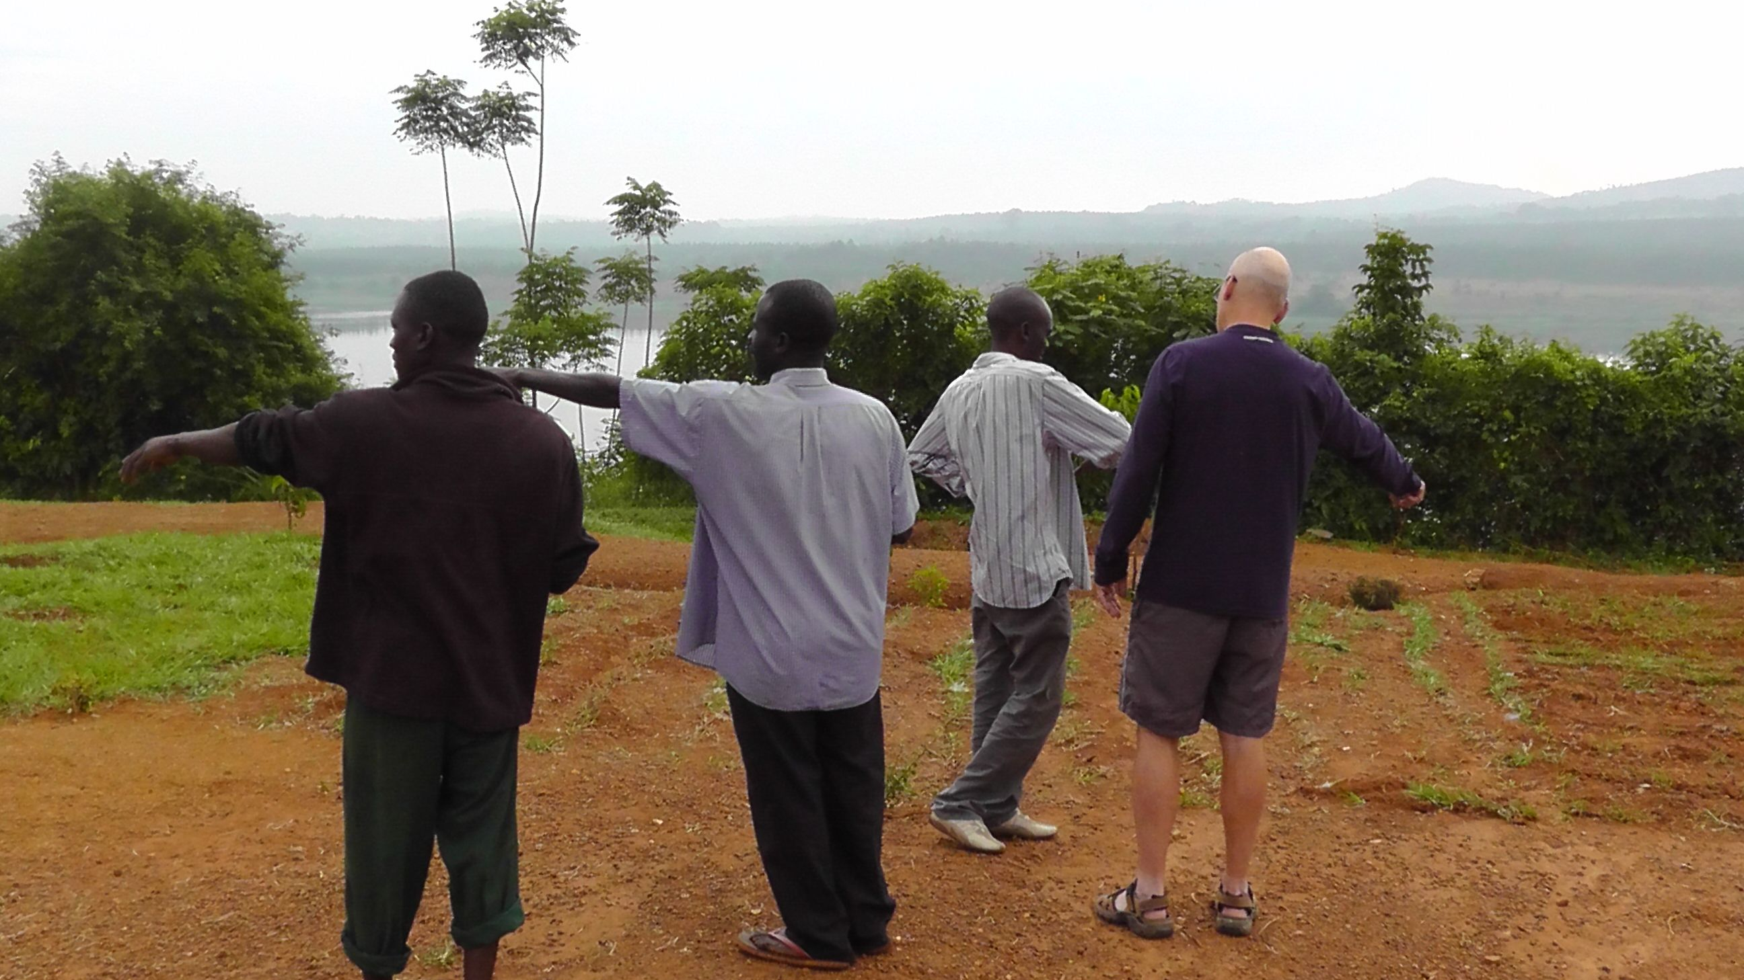

Slide 3
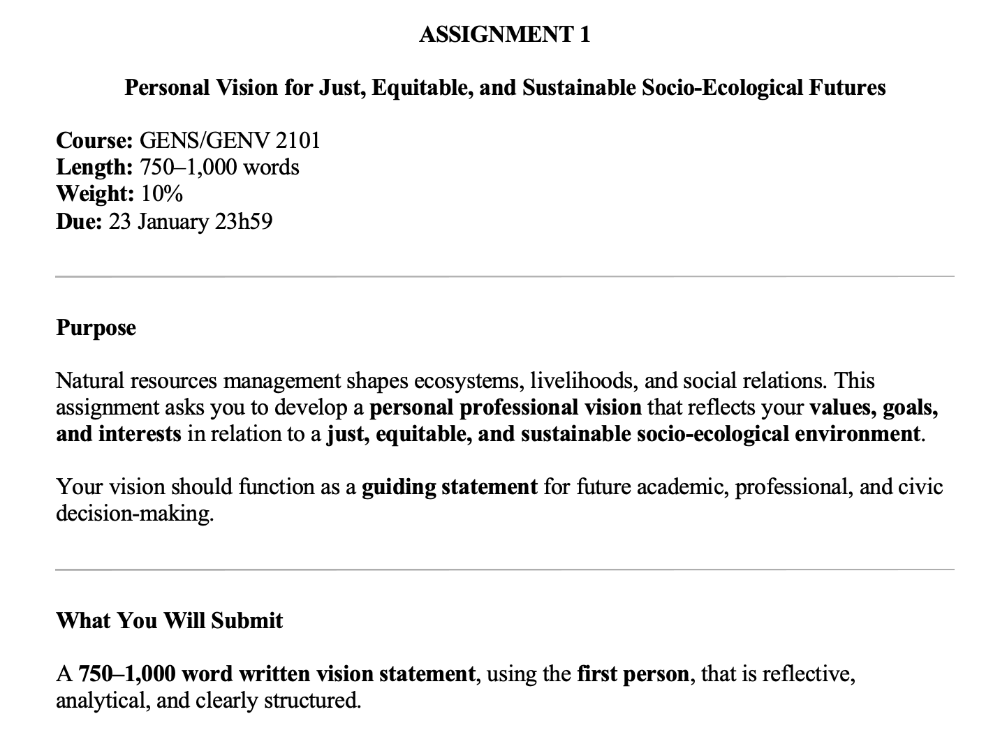

Slide 4
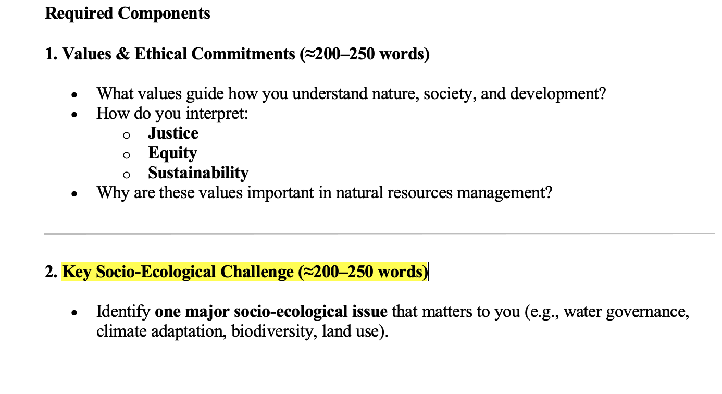

Slide 5
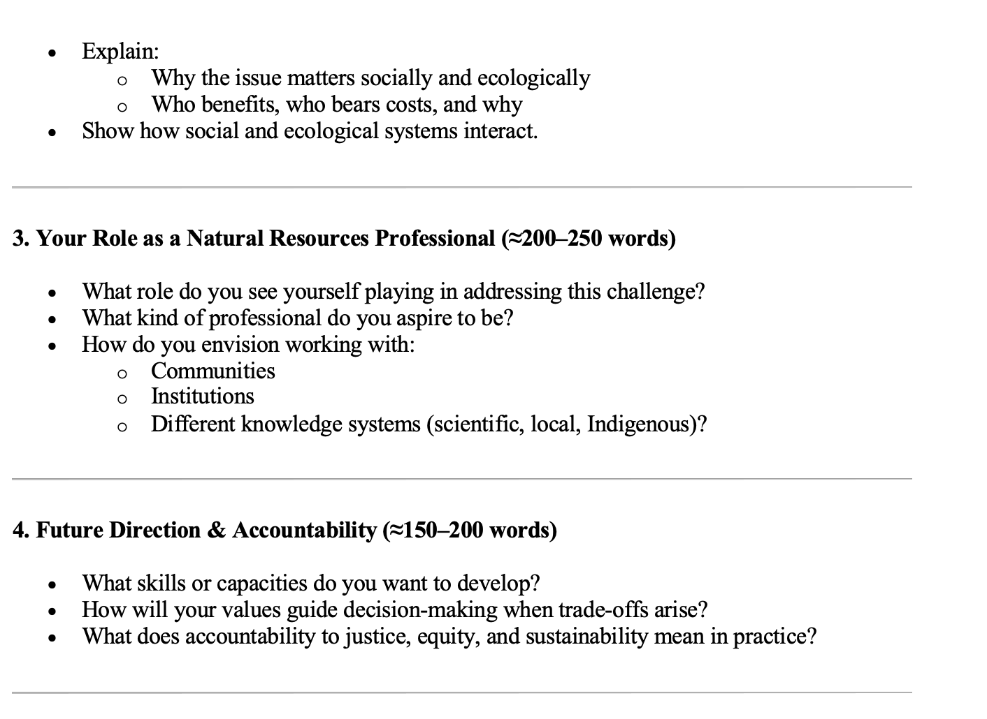

Slide 6
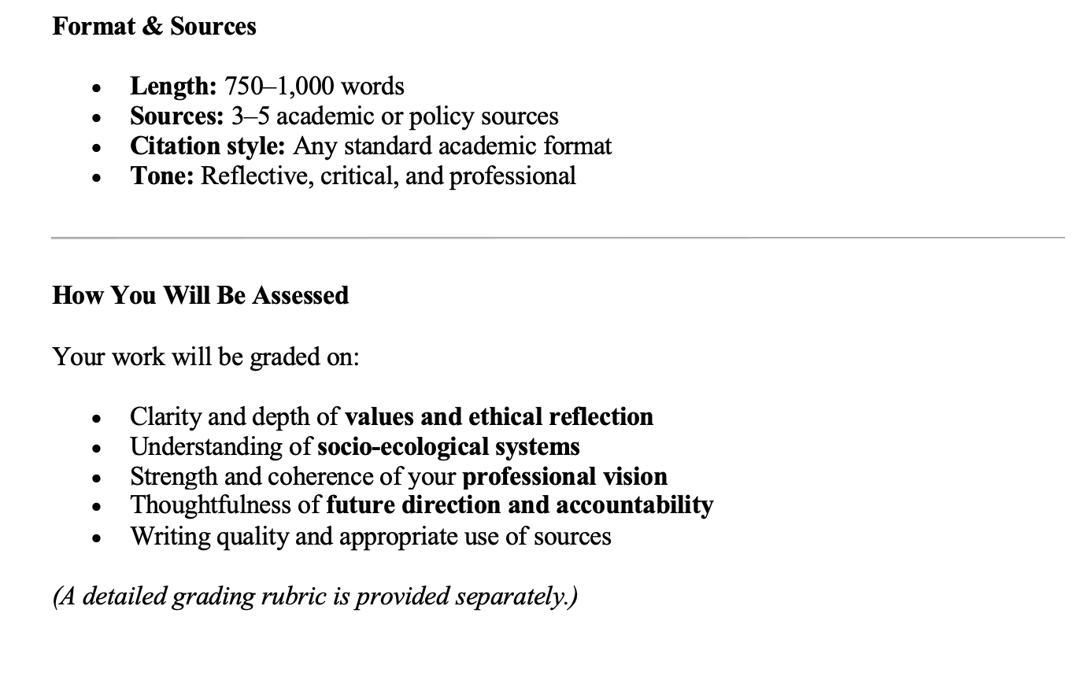

Slide 7
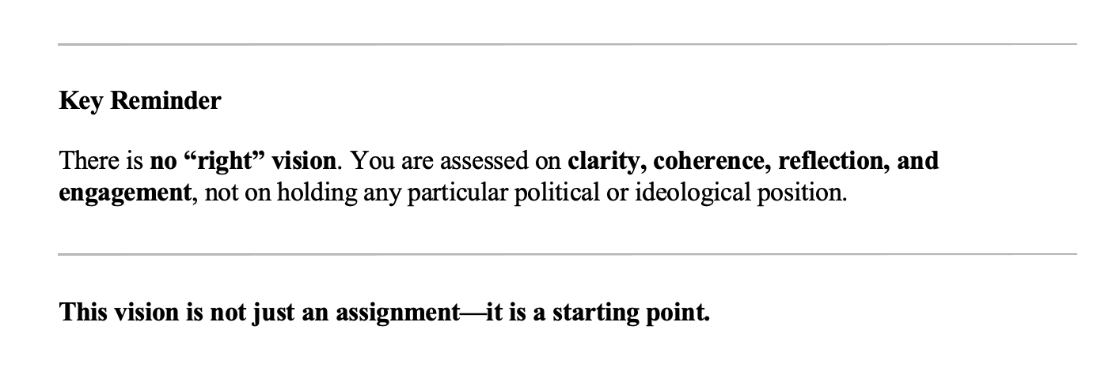

Slide 8
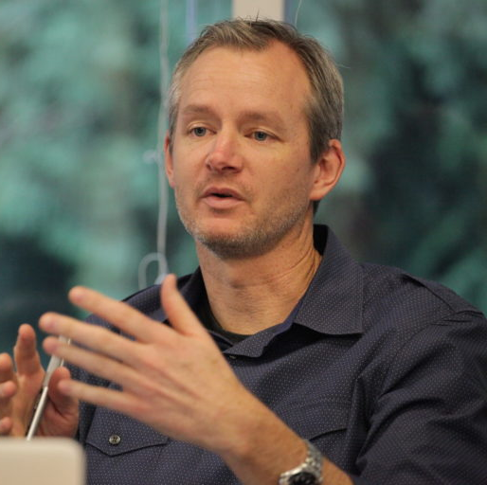
What is ‘natural resources management’?
NRM “is an adaptive and collaborative process through which actors across scales manage social–ecological systems to sustain ecosystem functions, livelihoods, and resilience in the face of change”
Derek Armitage (2009)

Slide 9
Government of Canada Definition
Natural resource management is ”the sustainable development, conservation, and wise use of Canada's natural resources (land, water, minerals, forests, wildlife) for current and future generations, balancing economic prosperity with environmental protection through science, policy, regulation, and collaboration to ensure long-term benefits and competitiveness.”
“Committed to improving the quality of life of Canadians by ensuring the country’s abundant natural resources are developed sustainably, competitively and inclusively”. (NRCAN homepage: https://natural-resources.canada.ca/)

Slide 10
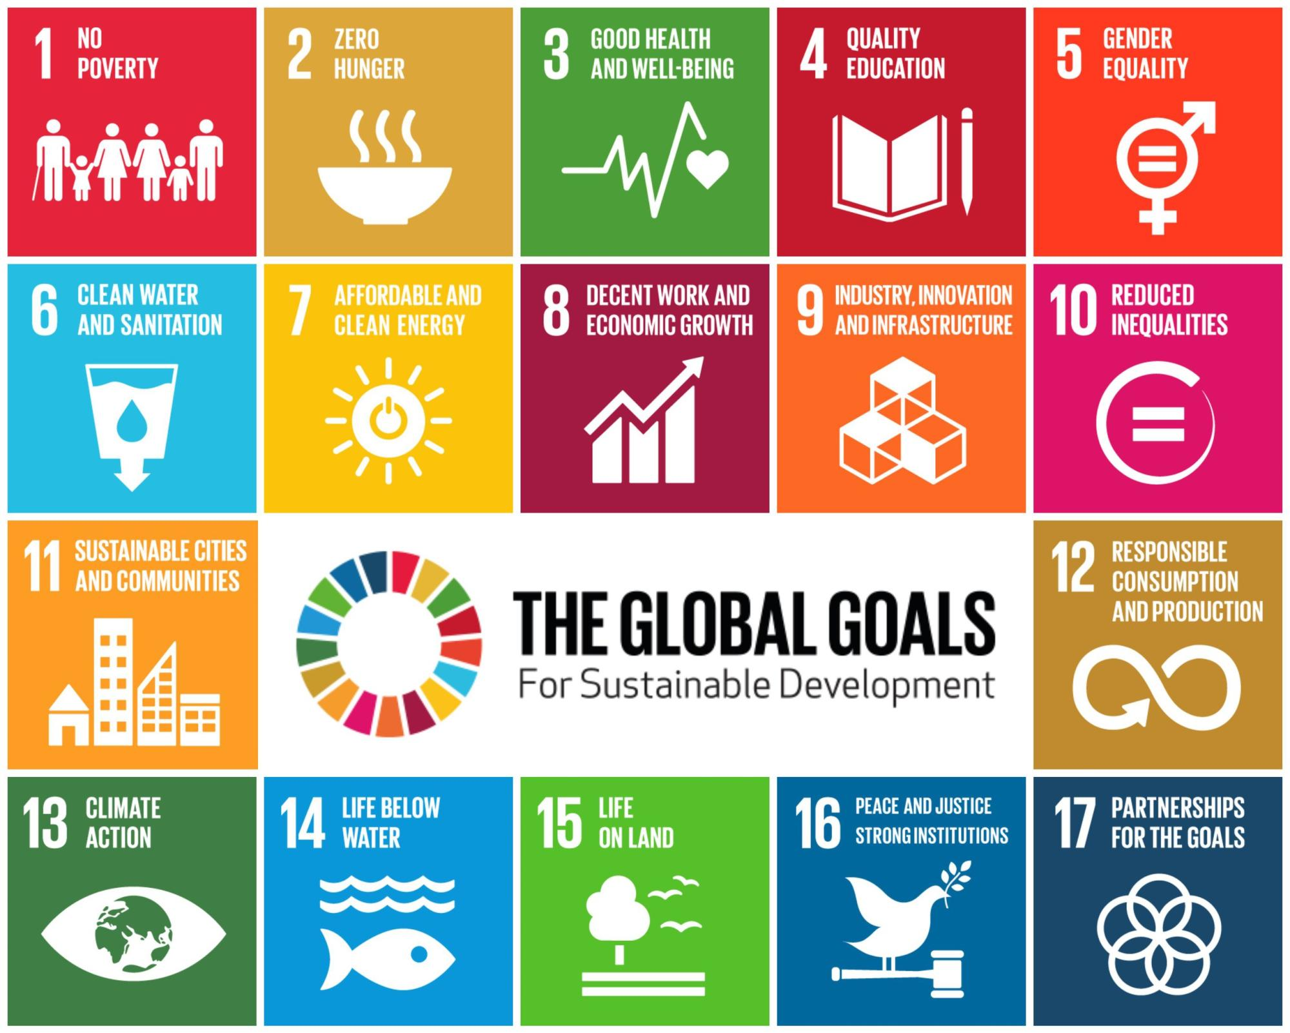
Sustainable Development
The Brundtland Report Our Common Future (1987), defines sustainable development as "development that meets the needs of the present without compromising the ability of future generations to meet their own needs.”
[https://sdgs.un.org/goals]

Slide 11
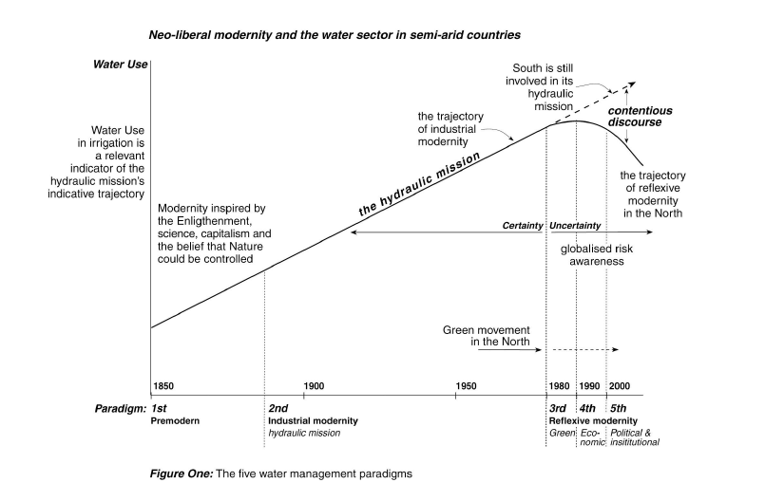
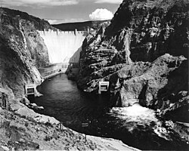
High Modern Definition of NRM?
Hoover Dam, 1936

Slide 12

Ken Conca, Governing Water
The ‘ought’
T: The river basin
A: All affected stakeholders
K: All relevant forms of knowledge (including TEK, IK, ‘local’)
The ‘is’
T: The sovereign state
A: The government (and partners)
K: The ‘expert’ (technical and financial)
*TAK = Territory, Authority, Knowledge

Slide 13
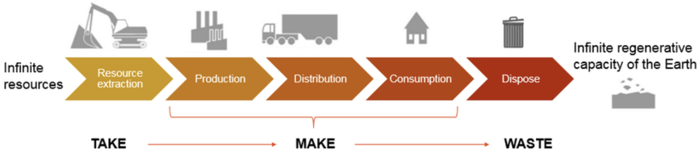
Traditional Resource Management System

Slide 14
Traditional resource management
Reached its apex in the “high-modern industrial” age (Allan’s Paradigm 3)
Humans manage nature
The ‘system’ is linear and predictable (”uncertainty” is minimized or ignored)
The primary focus is to maximize resource yield and efficiency
The knowledge base is technical and expert-driven
Governance is centralized, sectoral
Characterized by top-down decisions with a “command and control” approach

Slide 15
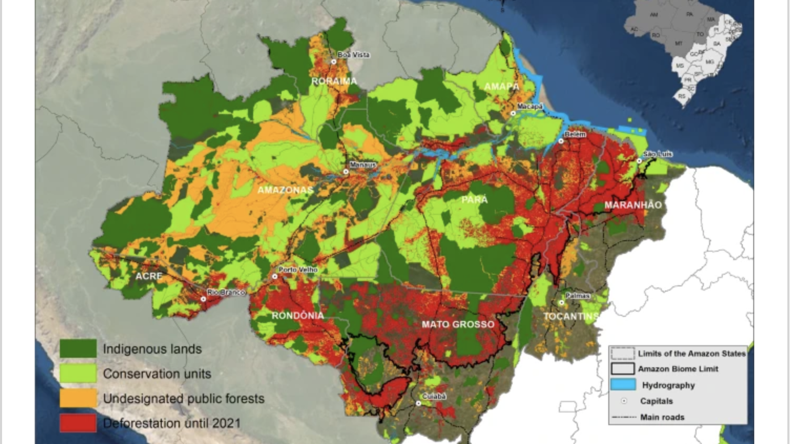

Slide 16
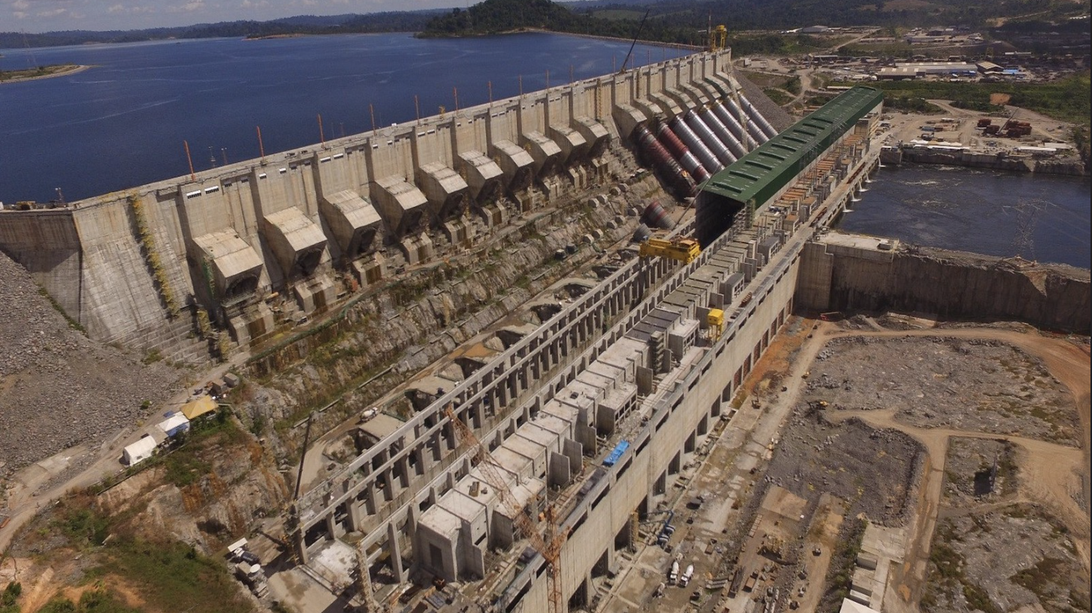

Slide 17
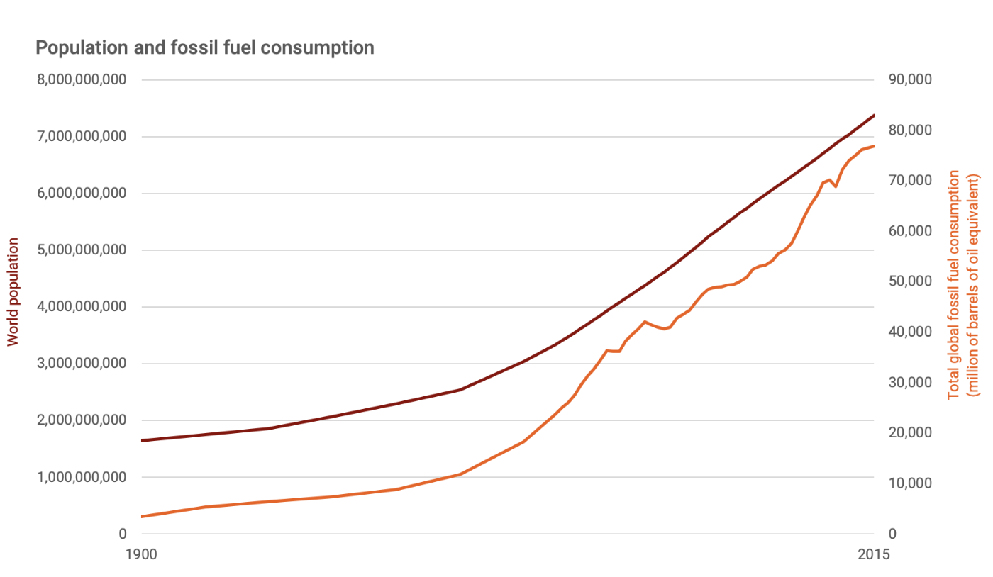

Slide 18
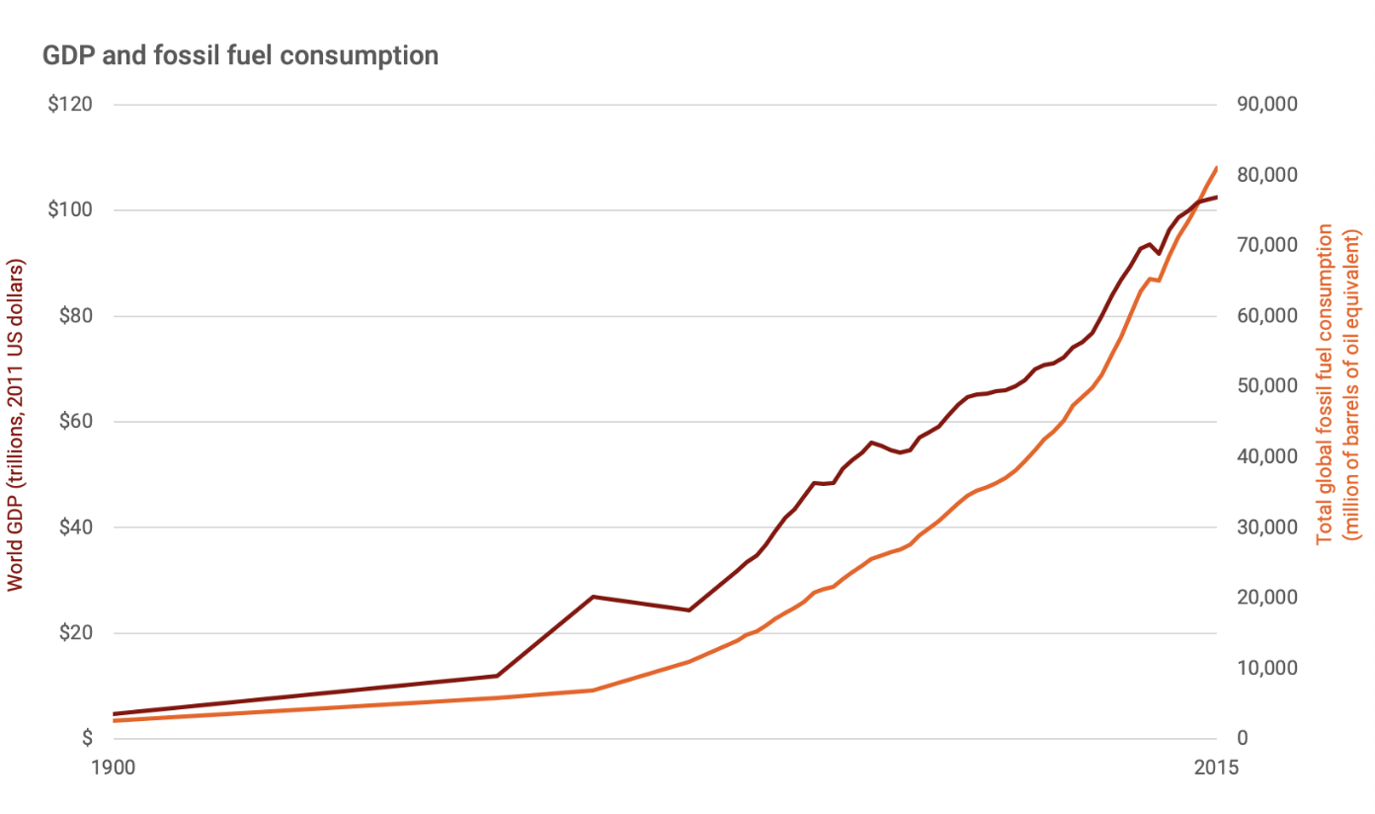

Slide 19
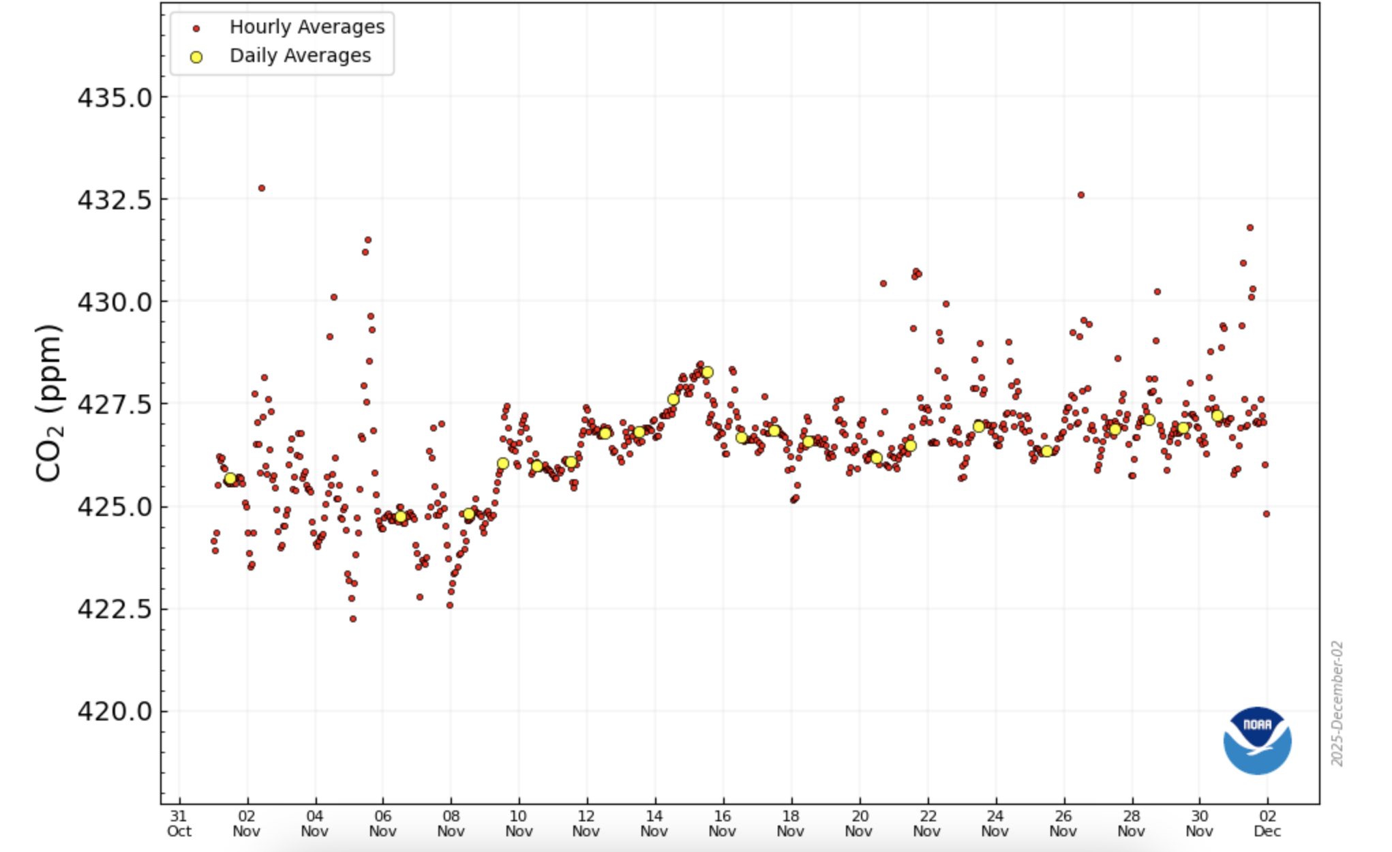
CO₂ levels at Mauna Loa; 427.22 ppm on 30.11.25

Slide 20

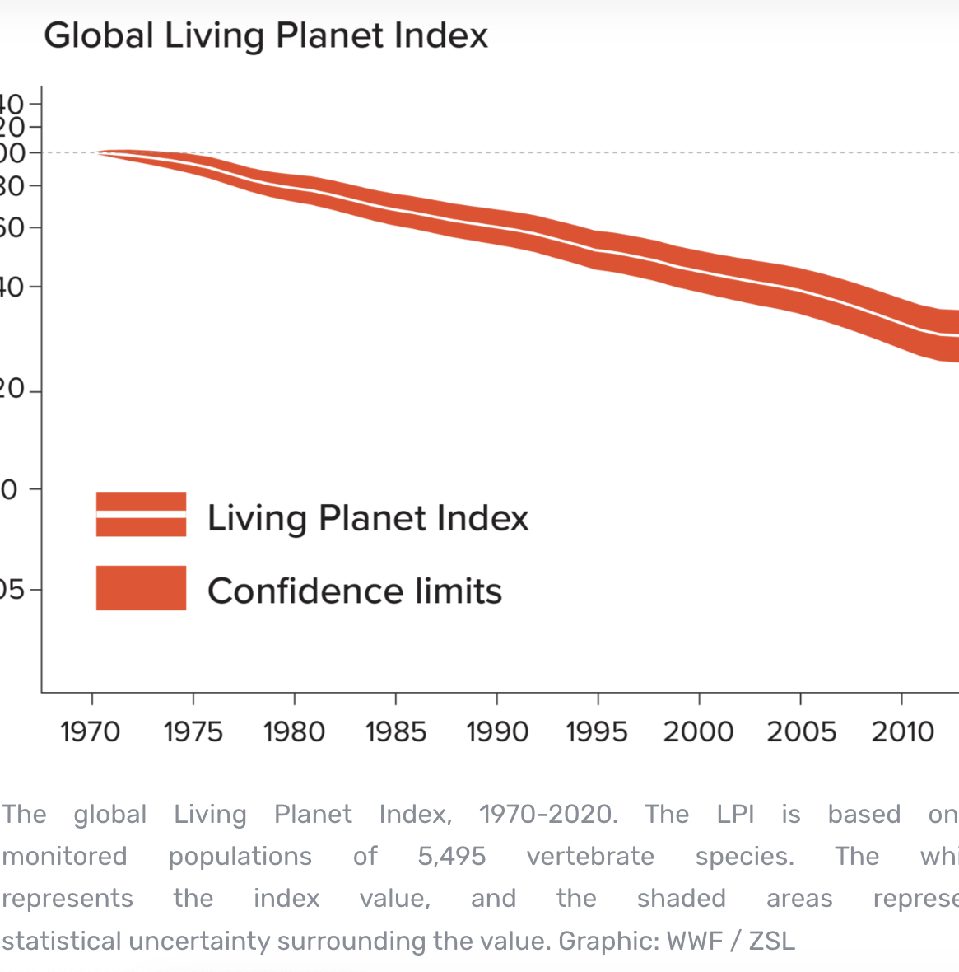

Slide 21
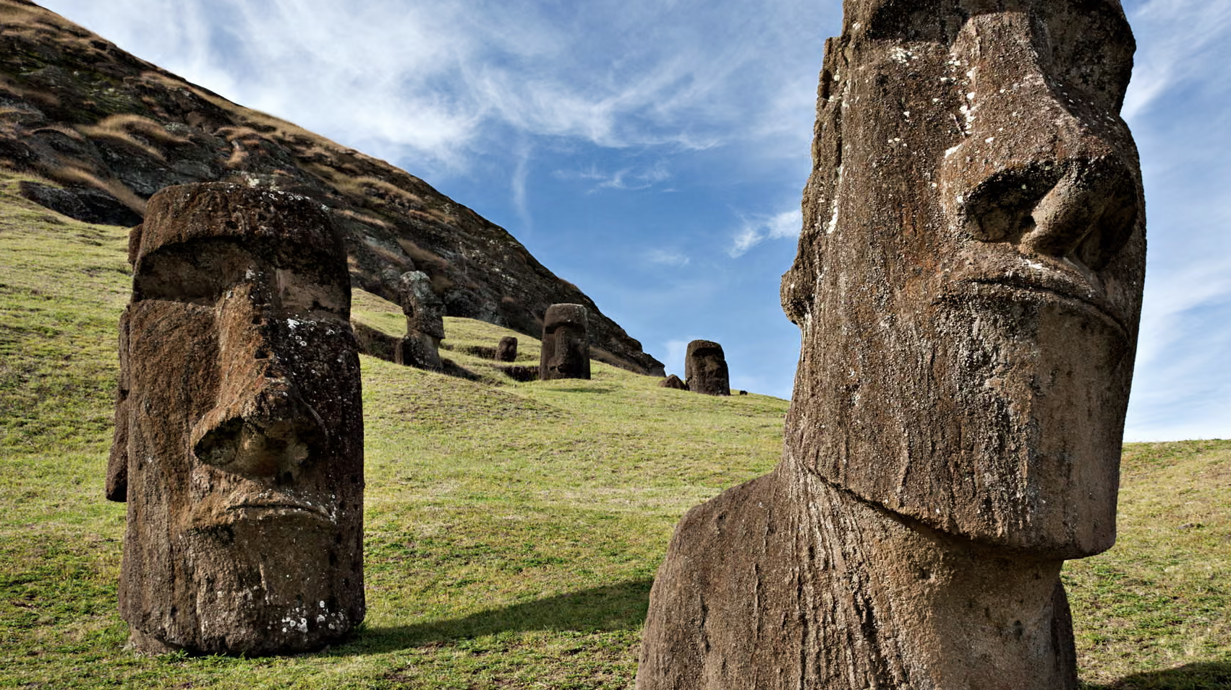
Poor Management reflects Poor Governance
Notes:
Moai statues on Easter Island

